Slide 1
CHAPTER 19
Oxidative Phosphorylation I
Xiao-Wei Chen, Ph.D.
xiaowei_chen@pku.edu.cn

Slide 2
Outline of the lecture
Overview of oxidative metabolism and mitochondria
The electron transport chain (ETC)
ATP synthesis

Slide 3
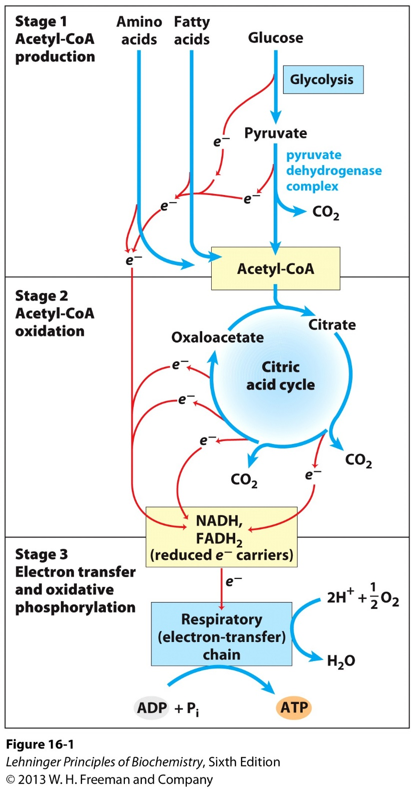
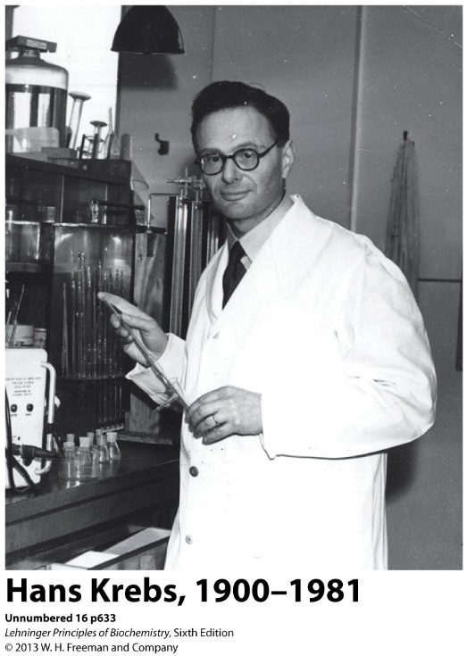
The Citric Acid Cycle
Also known as the Tricarboxylic Acid Cycle (TCA),
or the Krebs Cycle
The final common pathway involved in the oxidation of carbohydrates, fats, and proteins into CO₂ and H₂O to generate ATP by linking with oxidative phosphorylation);

Slide 4
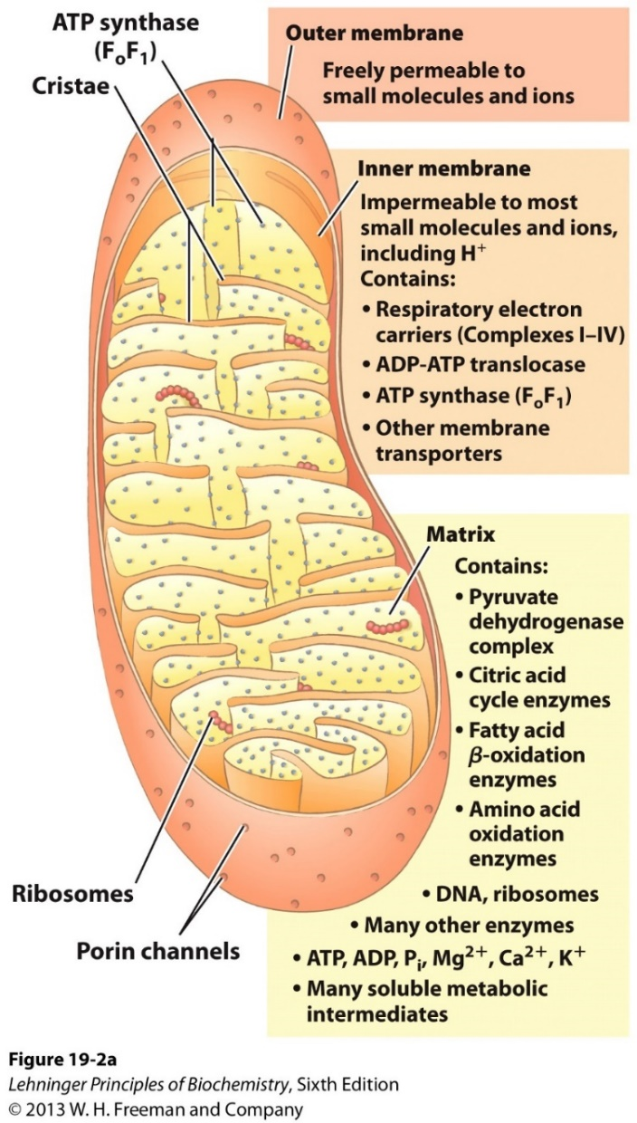
Oxidative phosphorylation: production of ATP inside of the mitochondrion
Oxidation of NADH and FADH₂
O₂ as the final electron acceptor (cellular respiration)
Happens inside of mitochondrion
Outer membrane: permeable
Inner membrane: impermeable
Matrix: enriched with enzymes and cofactors

Slide 5
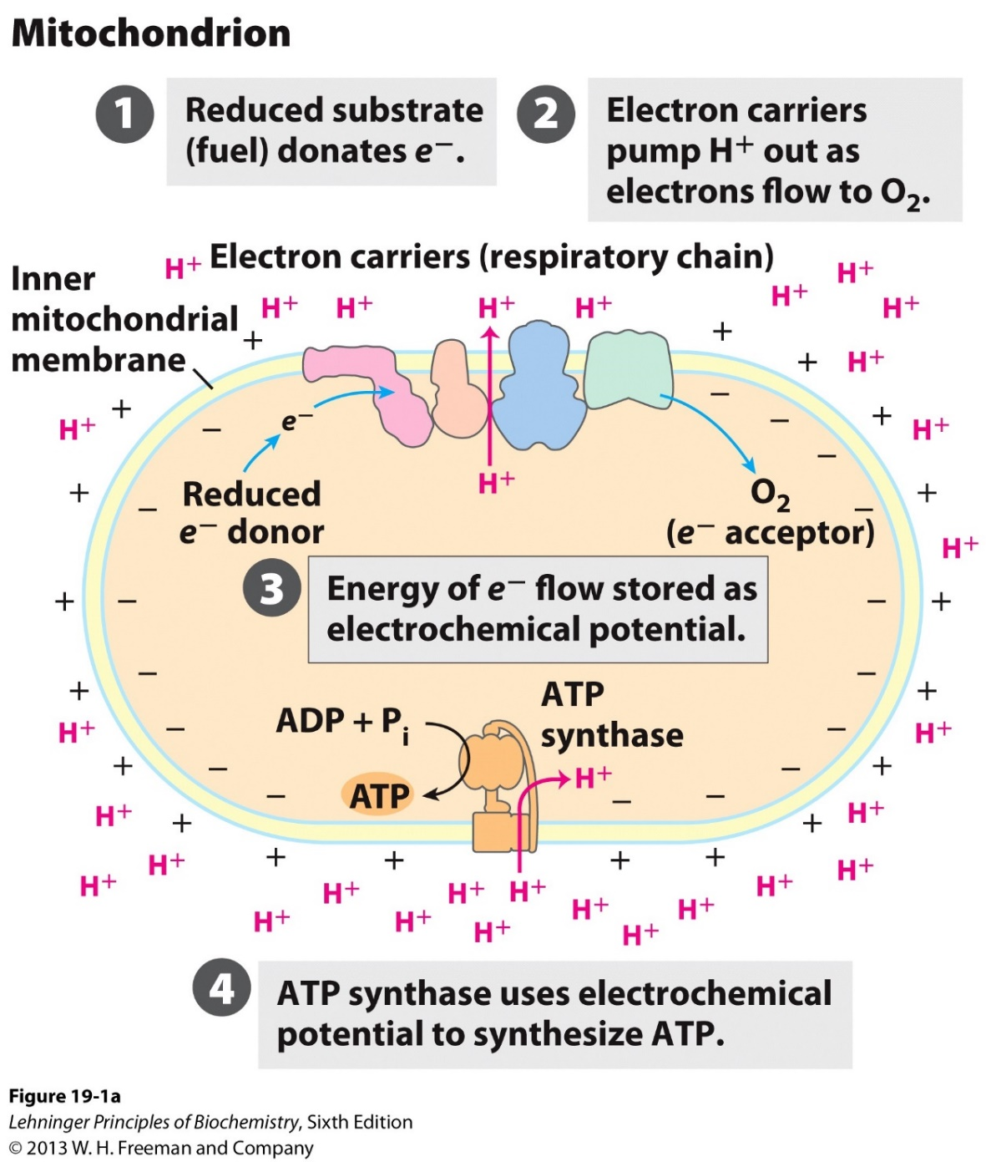
How to convert electrons into ATP?
Electron-transfer chain
Enable electron flow
Pump H⁺ to generate a proton gradient
ATP synthase
Use proton gradient to power ATP synthesis

Slide 6
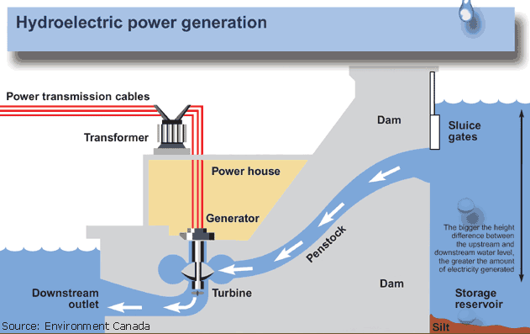
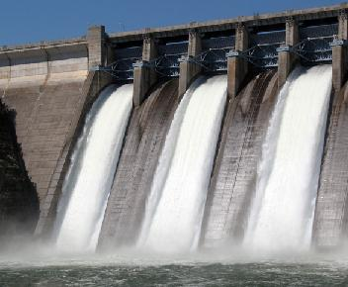
Comparison between the two potential powers:
Proton gradient and water fall
How to generate the proton gradient?

Slide 7
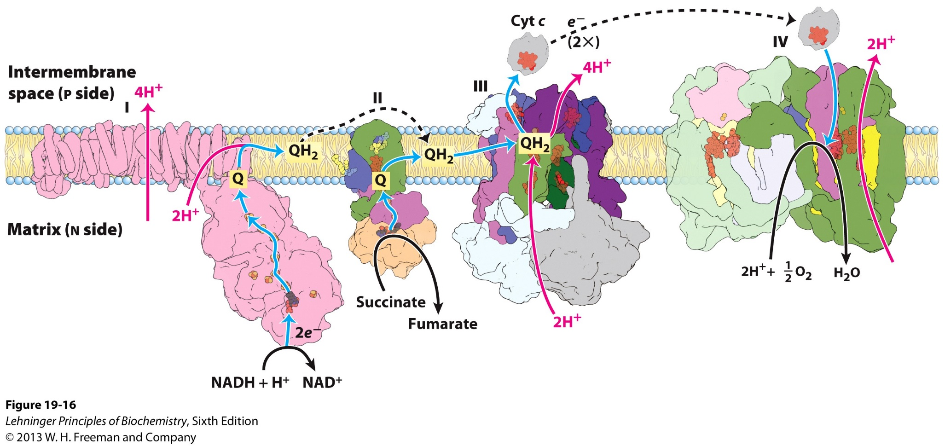
The electron transfer chain (ETC) pumps protons to establish a gradient
Four complexes, two electron carriers.
Electrons flow through the ETC.
The electron “current” pumps protons.

Slide 8
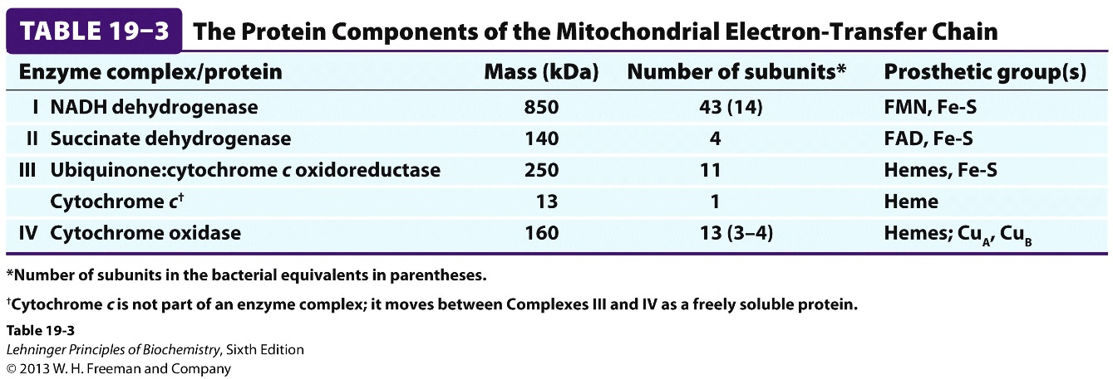
The four enzyme complexes in the ETC
Ubiquinone
A small hydrophobic molecule, can move along membranes
Cytochrome C
A small, water soluble protein, containing Fe (in Heme groups).

Slide 9
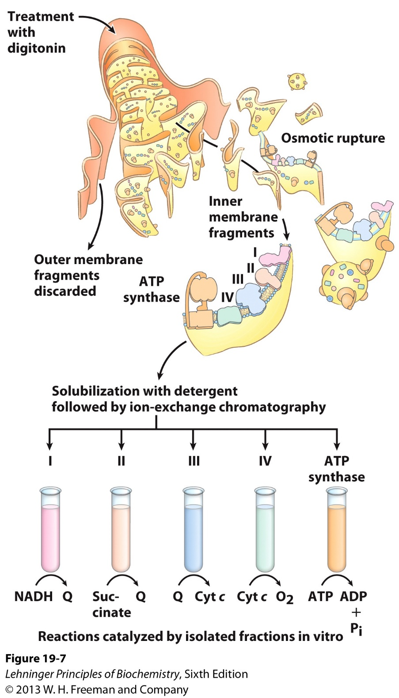
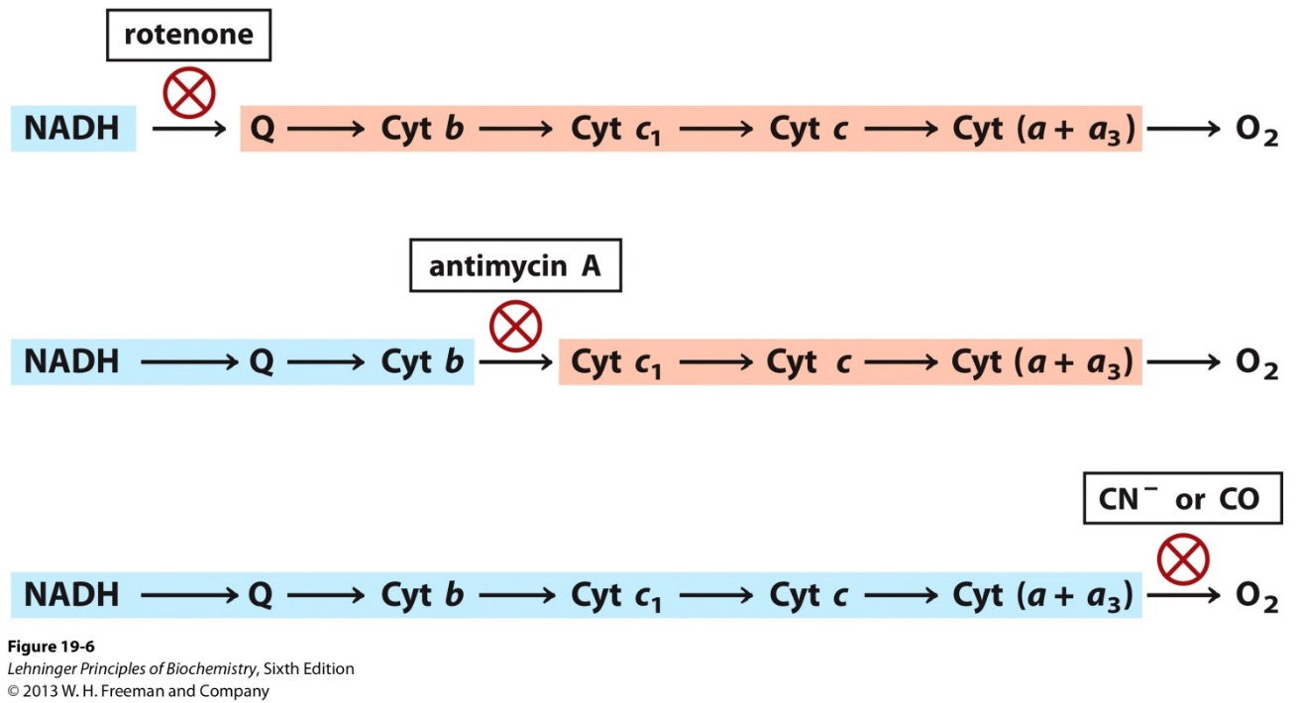
Separation of the functional complexes of the ETC

Slide 10
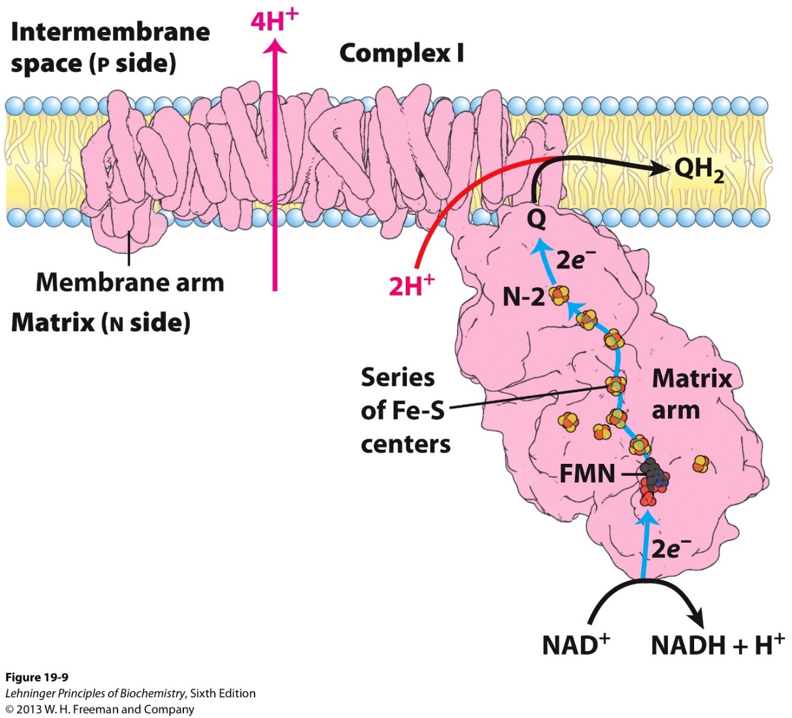
Complex I (NADH dehydrogenase) oxidizes NADH, generates QH₂, and pumps 4 protons
Exoergonic
Electron transfer from NADH to Q
Endergonic
Pumping 4 protons to the P side
Rotenone
Piericidin A
NADH
NAD⁺ + H⁺

Slide 11
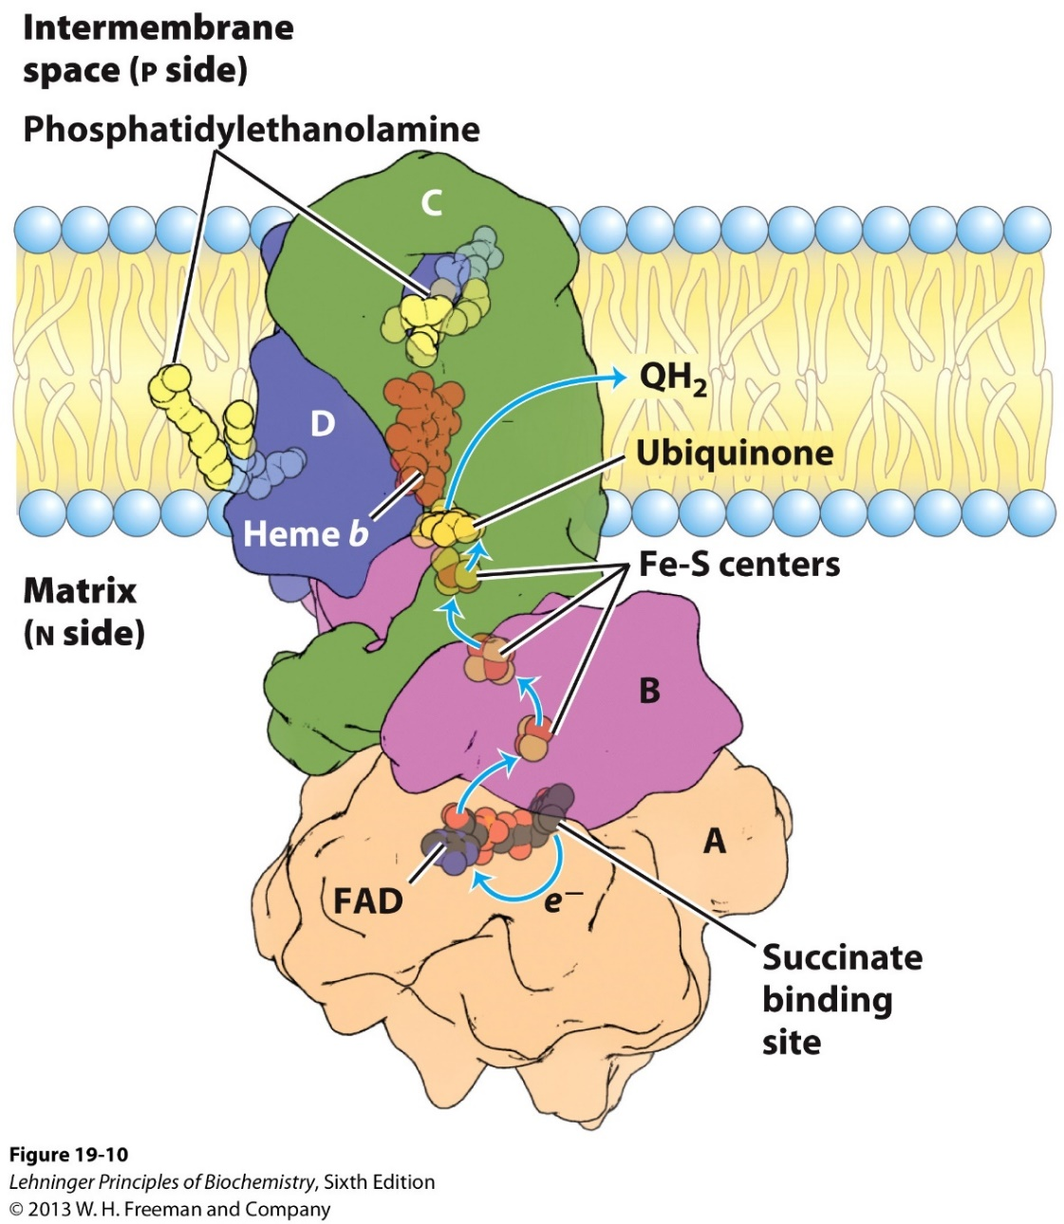
Complex II (Succinate dehydrogenase) oxidizes FADH₂ and generates QH₂
The only membrane bound enzyme in TCA
Oxidize FADH₂
Transfer electrons to Q
Does NOT pump protons

Slide 12
A summary of complex I and complex II
 | Complex I | Complex II
Electron acceptor | Q (into QH₂) | Q (into QH₂)
Electron donor | NADH | FADH₂
Proton pumped | 4 | 0

Slide 13
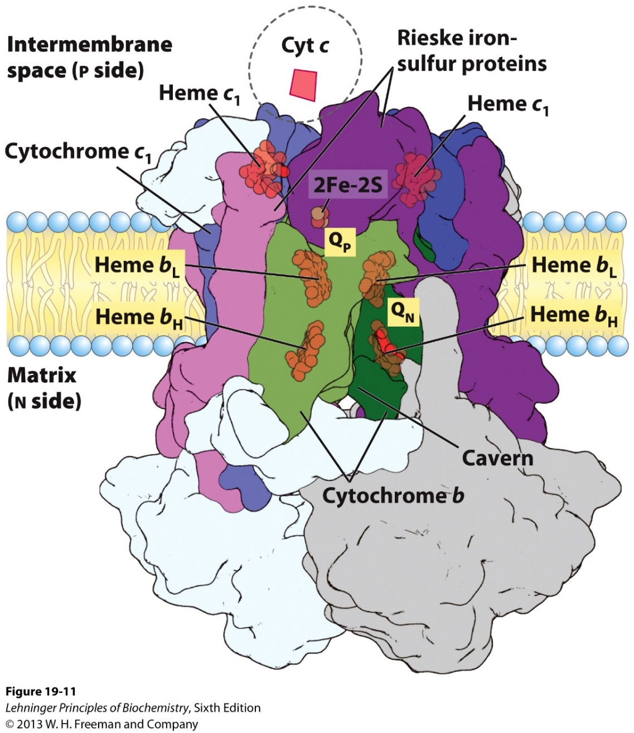
Complex III passes electrons from QH₂ to the Cyto C, and pumps 4 protons
Ubiquinone-Cytochrome C oxidoreductase
Cytochrome C is water soluble, can accept one electron.

Slide 14
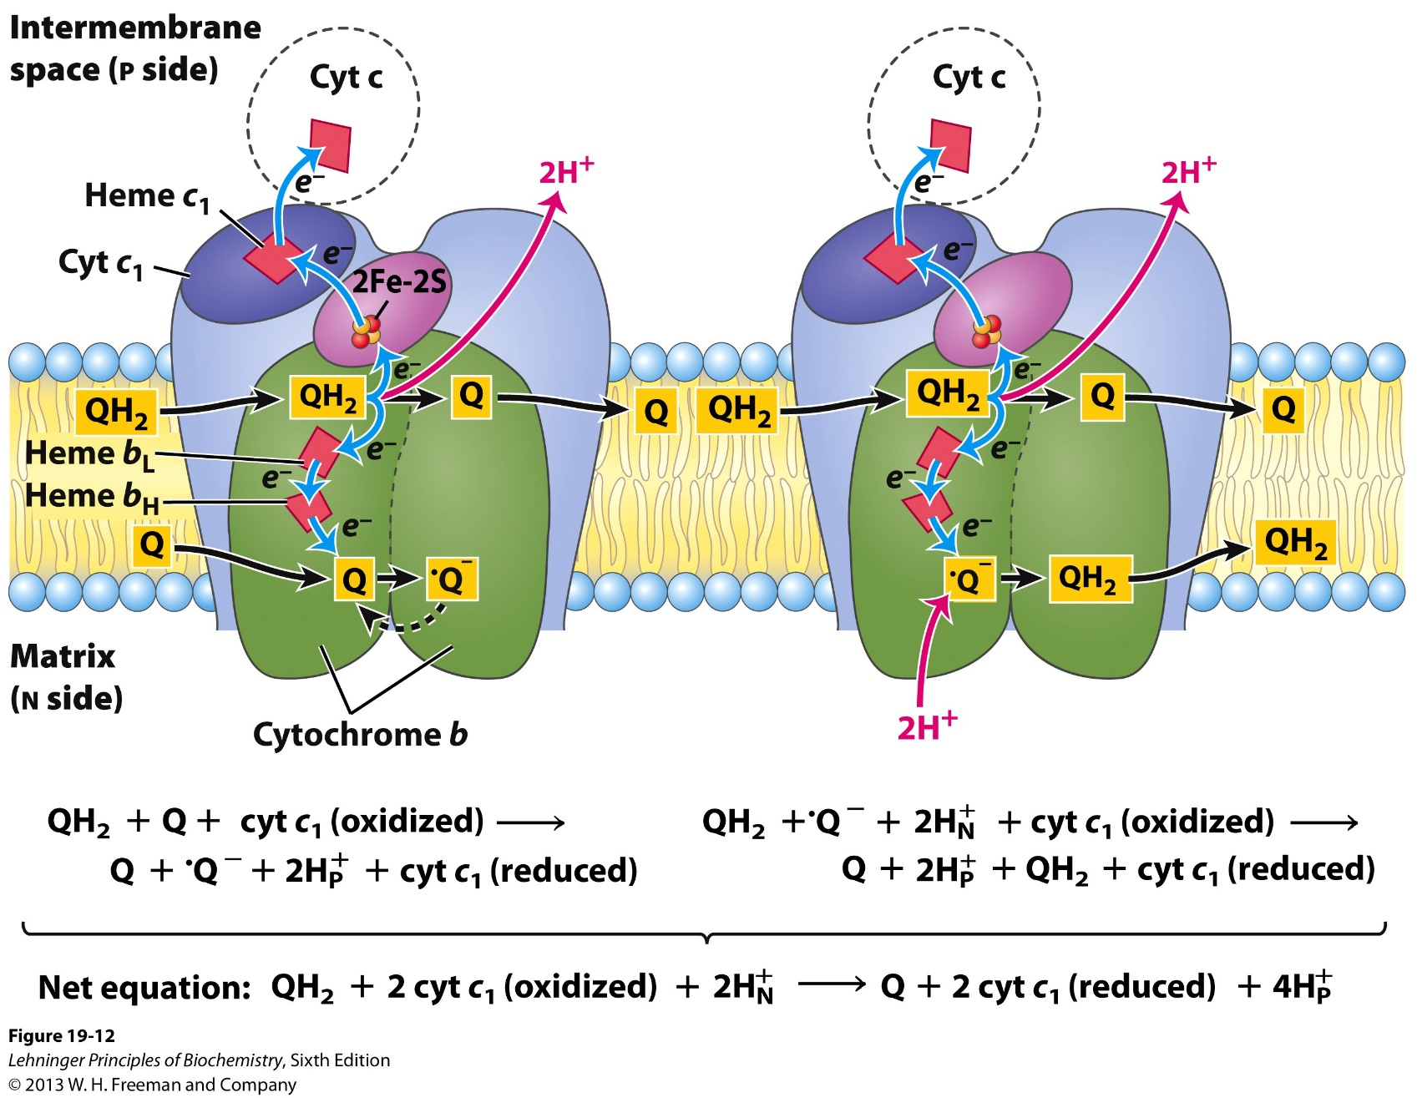
The Q cycle, in two stages.

Slide 15
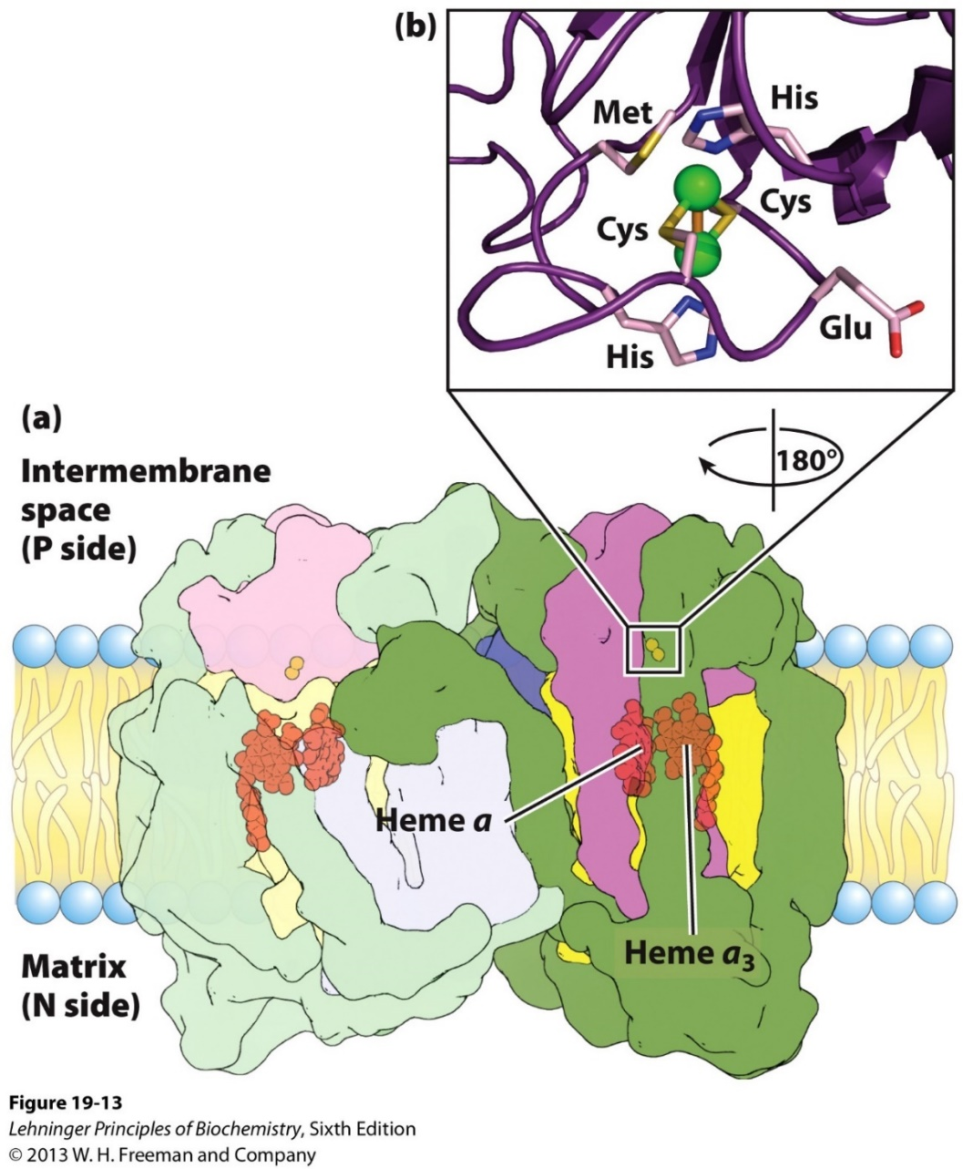
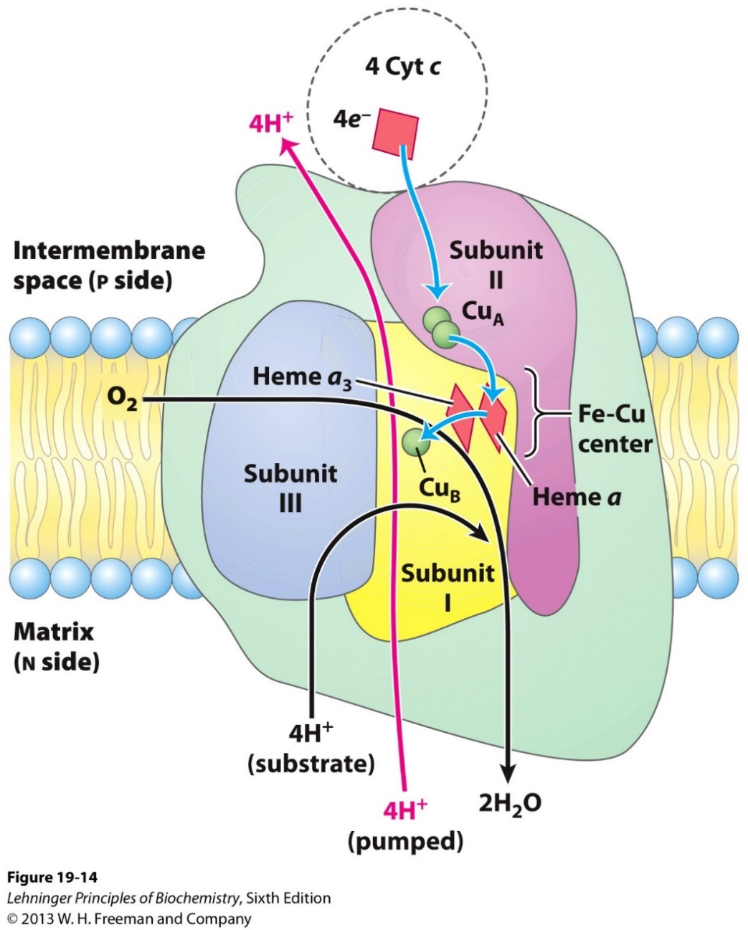
Complex IV (Cytochrome oxidase) passes electrons from Cyto C to O₂, and pumps 2 protons

Slide 16
The electron transfer chain (ETC) pumps protons to establish a gradient
How many protons are pumped with 1 NADH?
How many protons are pumped with 1 FADH₂?

Slide 17
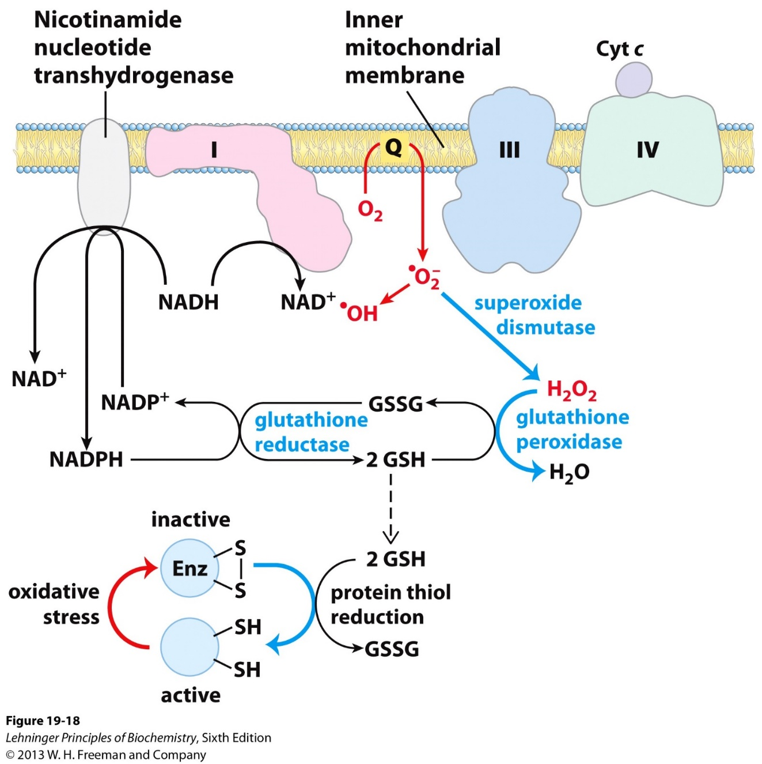
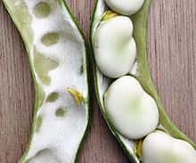
ROS production from “leaky” ETC
Fava beads 蚕豆

Slide 18
Comparison between the two potential powers:
Proton gradient and water fall
H⁺
H⁺
H⁺
H⁺
H⁺
H⁺
How to generate ATP from the proton gradient?

Slide 19
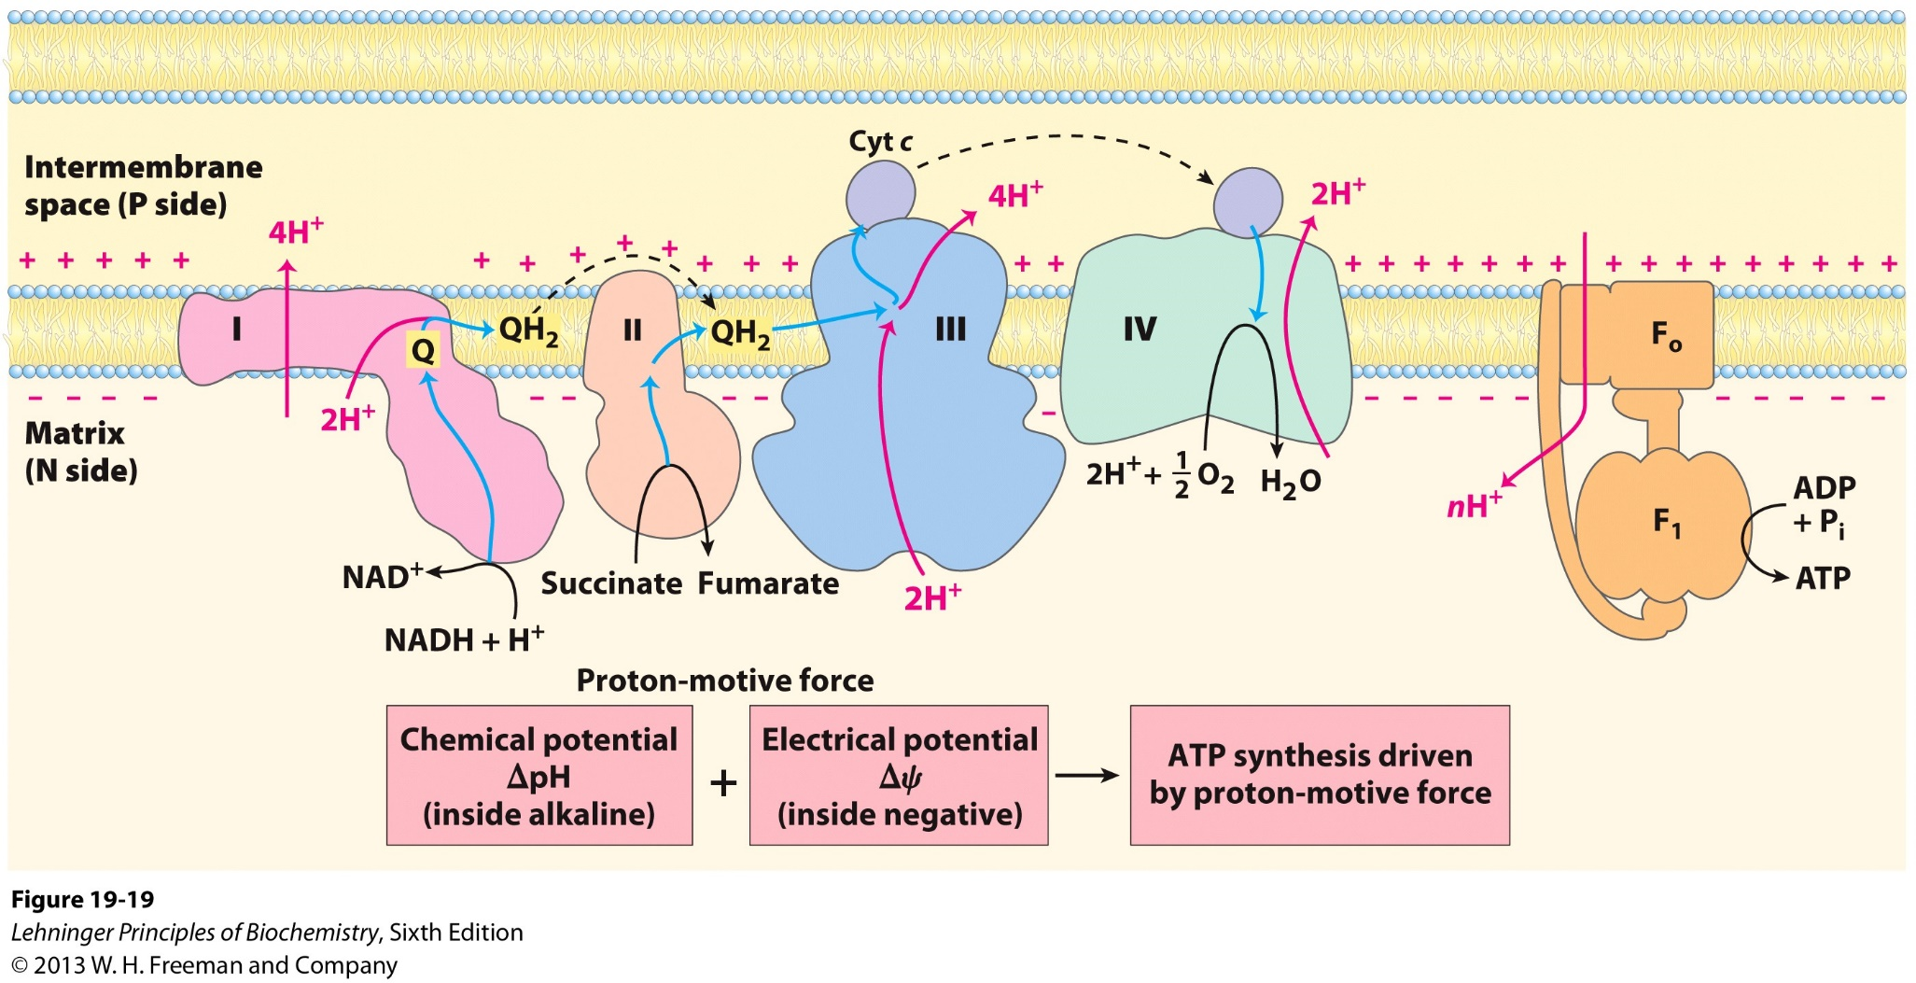
The chemiosmotic model: ATP synthesis driven by the proton gradient across inner mitochondrial membrane

Slide 20
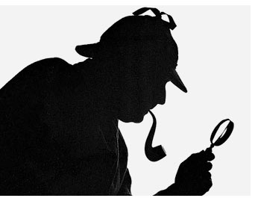
A detective story for understanding ATP synthesis
What makes ATP?
Who makes ATP?
An unusual problem
A solution
Who provides the solution?
The final link
The missing puzzle

Slide 21
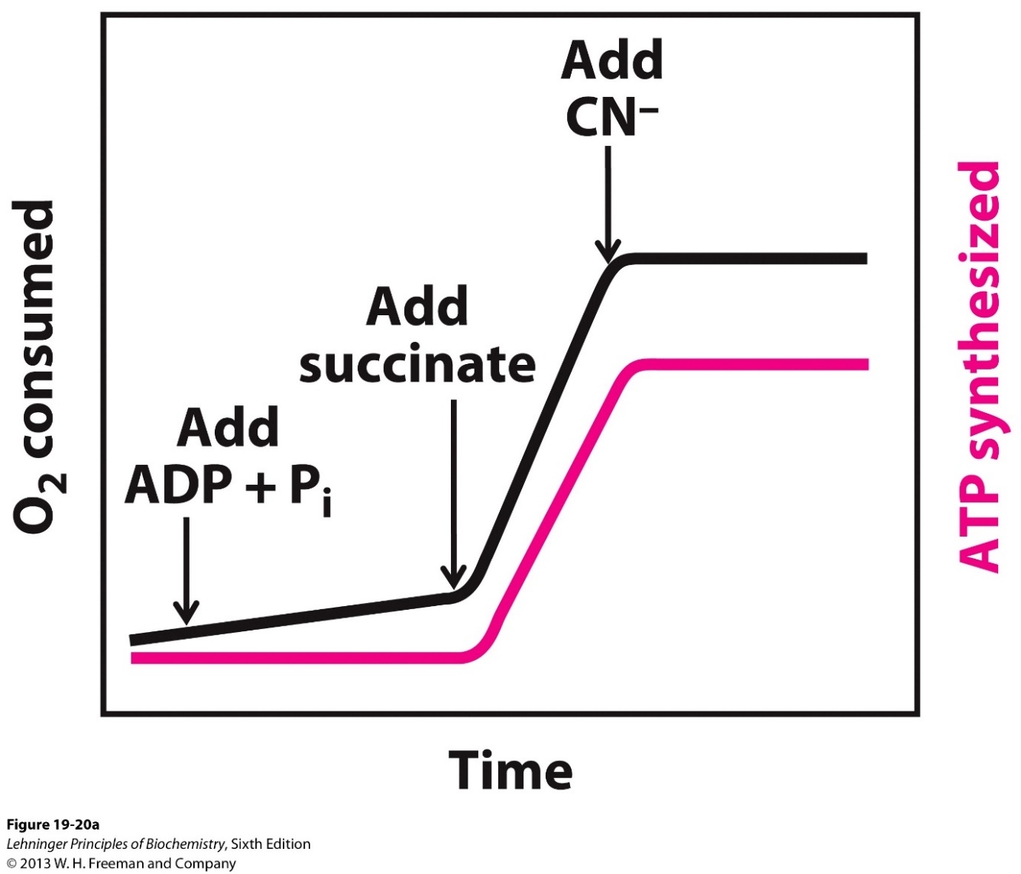
Coupling electron transfer with ATP synthesis
Isolated mitochondrion
Black: electron transfer
Red: ATP synthesis
ADP, Pi: precursors
Succinate: electron donor
CN⁻: toxin that blocks electron transfer

Slide 22
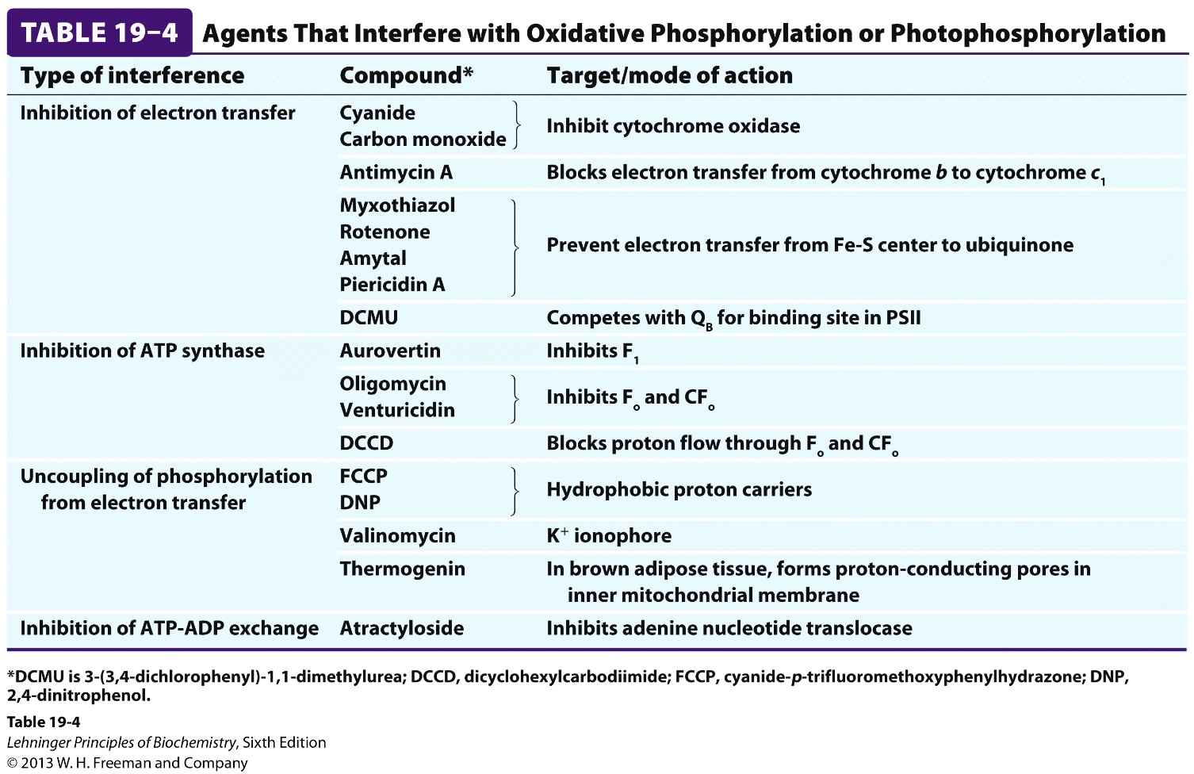
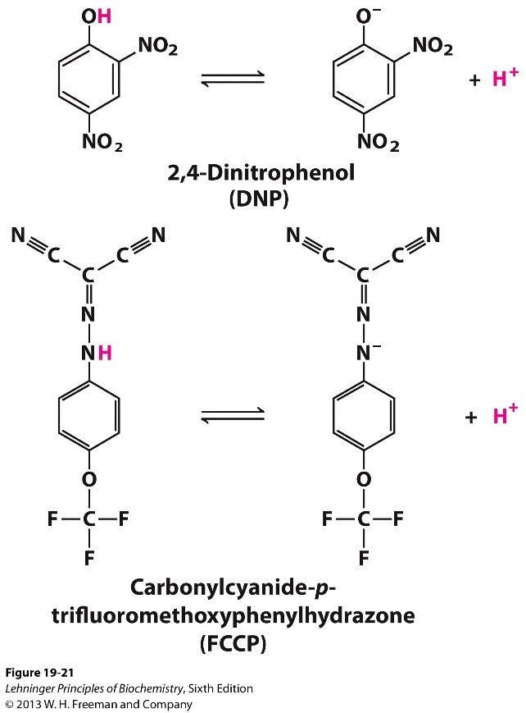
Toxins or antibiotics that interfere with oxidative phosphorylation

Slide 23
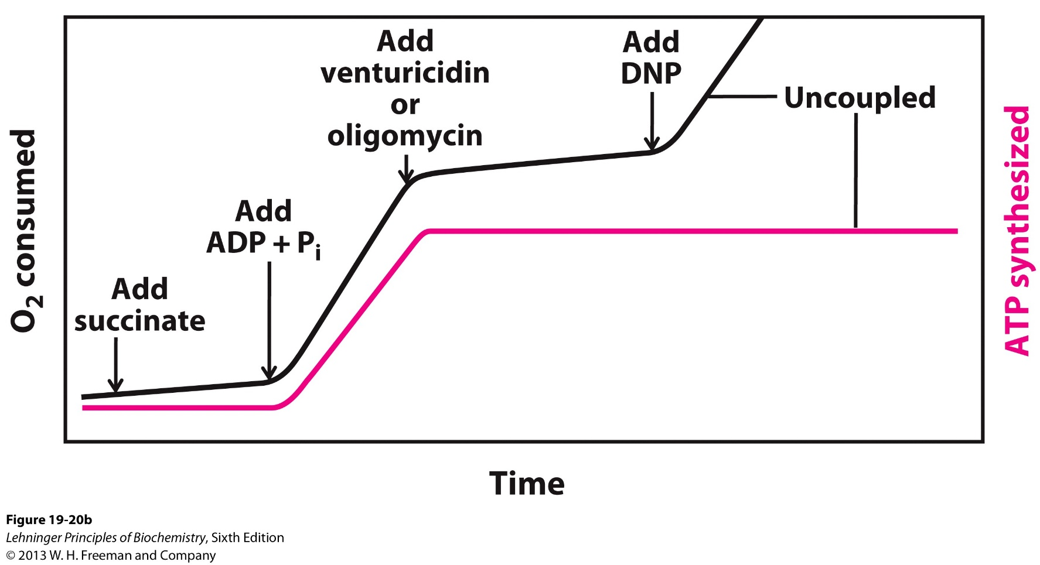
Uncouple electron transfer from ATP synthesis
Oligomycin: inhibits ATP synthesis
DNP: disrupts the proton gradient
Conclusion: the proton gradient is necessary for ATP synthesis

Slide 24
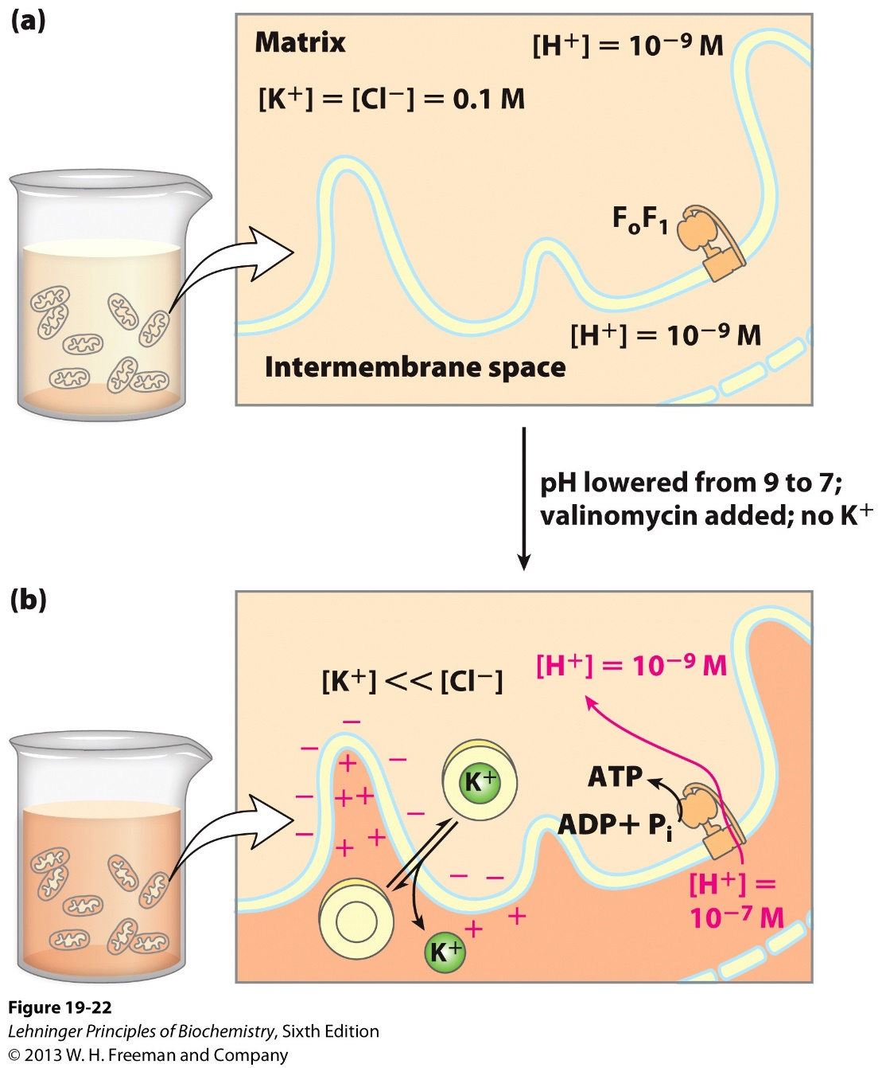
The proton gradient cross IMM is sufficient to drive ATP synthesis
NO ATP production
Isolated Mitochondria
Without oxidizable substrate
Without or with proton gradient
ATP production

Slide 25
A detective story for understanding ATP synthesis
What makes ATP?
The proton gradient
Who makes ATP?
An unusual problem
A solution
Who provides the solution?
The final link
The missing puzzle

Slide 26
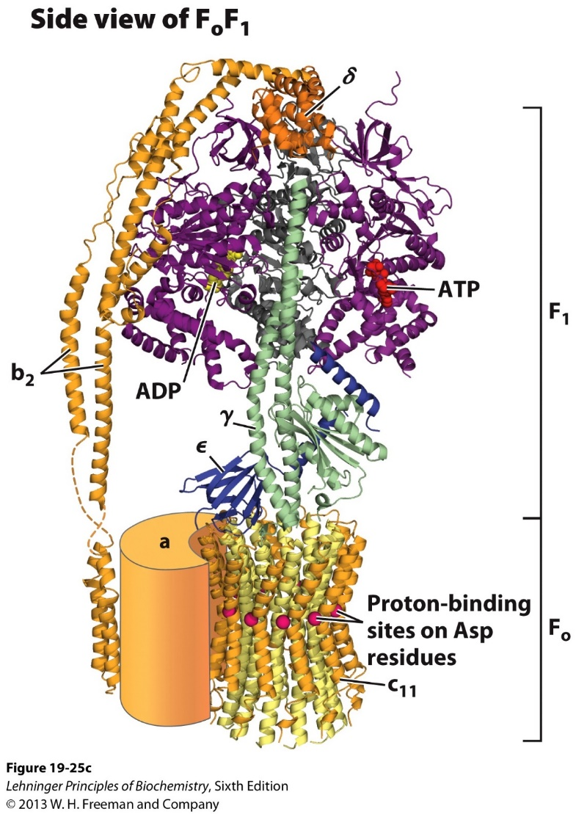
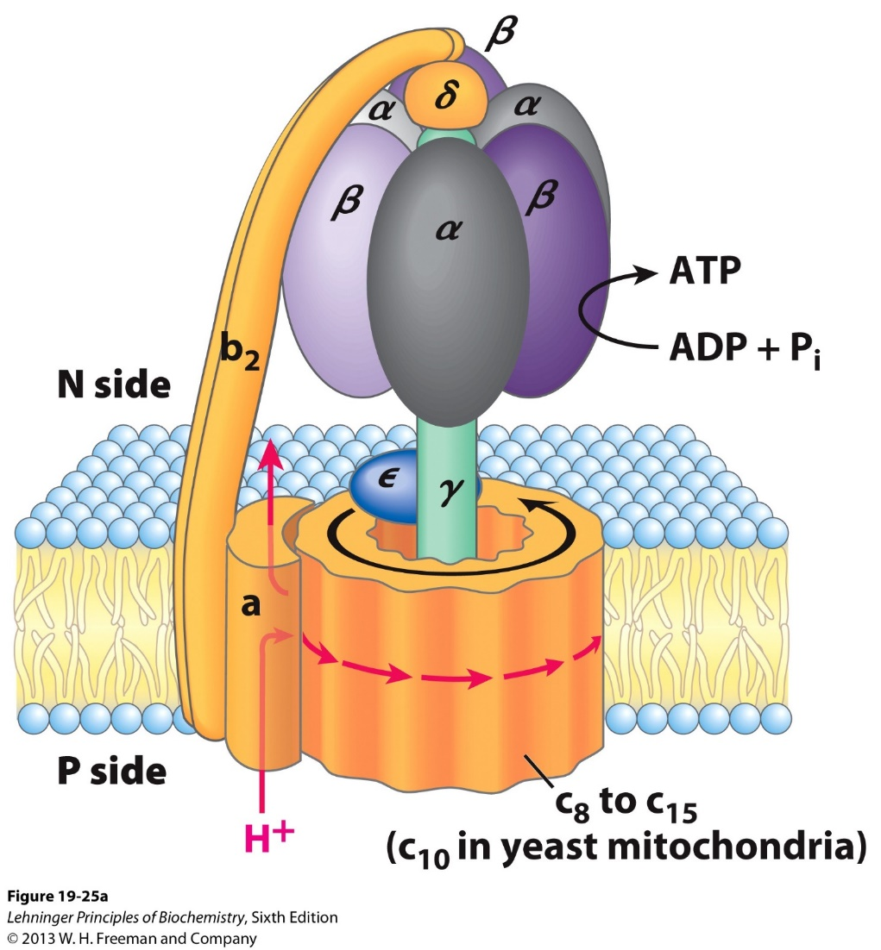
The structure of the ATP synthase: F₀ and F₁

Slide 27
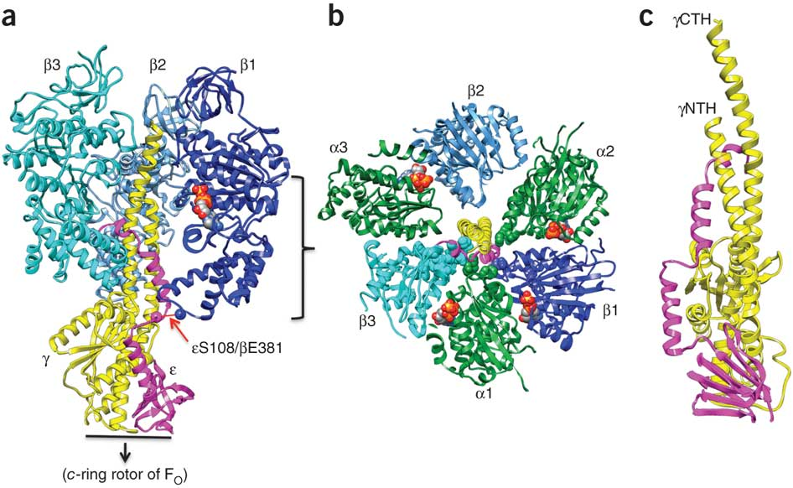
F₁ fragment of ATP synthase could mediate ATP hydrolysis (F₁ ATPase): α₃β₃ + γε + δ subunits
γε central stalk

Slide 28
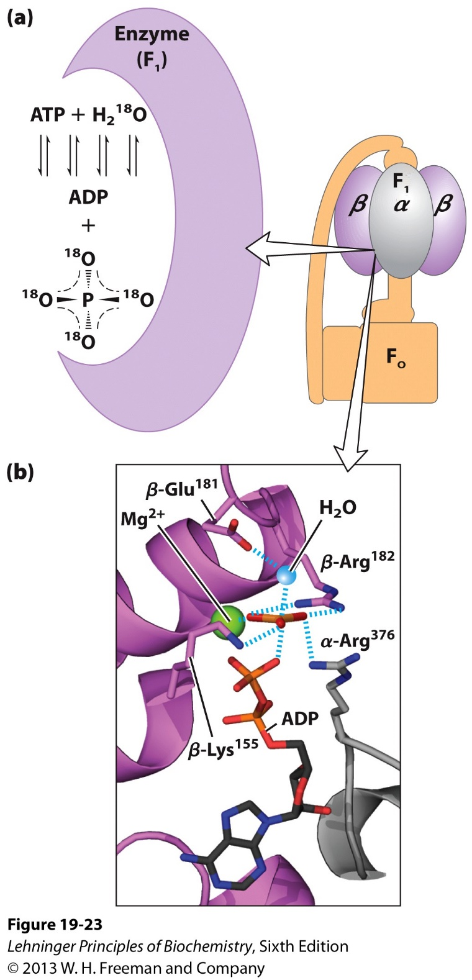
ATP synthesis in F₁-ATPase does not need the input of energy!
¹⁸O-Isotope exchange experiment: ATP is cleaved & reformed repeatedly with a △G^{’o} close to zero (K’_{eq} near 1);
ATP binds far more tightly than ADP ( with an K_{d} ~10⁶ fold different), thus releasing enough binding energy to counterbalance the cost of making ATP.
How to release ATP from the enzyme?

Slide 29
A detective story for understanding ATP synthesis
What makes ATP?
The proton gradient
Who makes ATP?
The F₁ ATPase/synthase
An unusual problem
A solution
Who provides the solution?
The final link
The missing puzzle

Slide 30
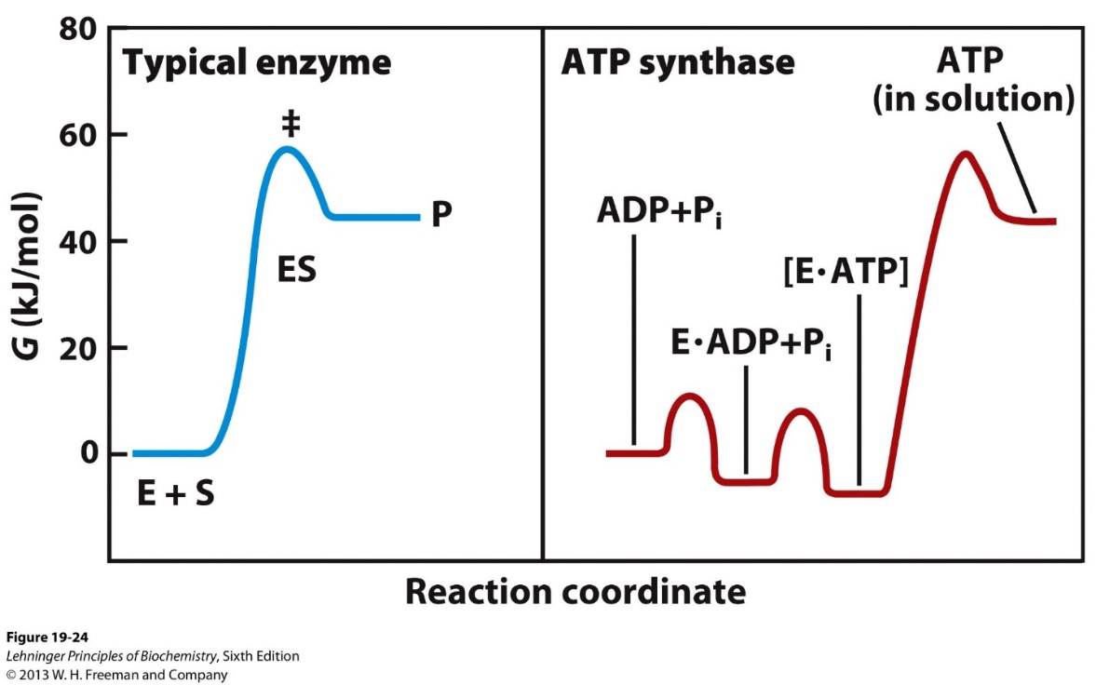
ATP release from the F₁ ATPase requires additional energy input

Slide 31
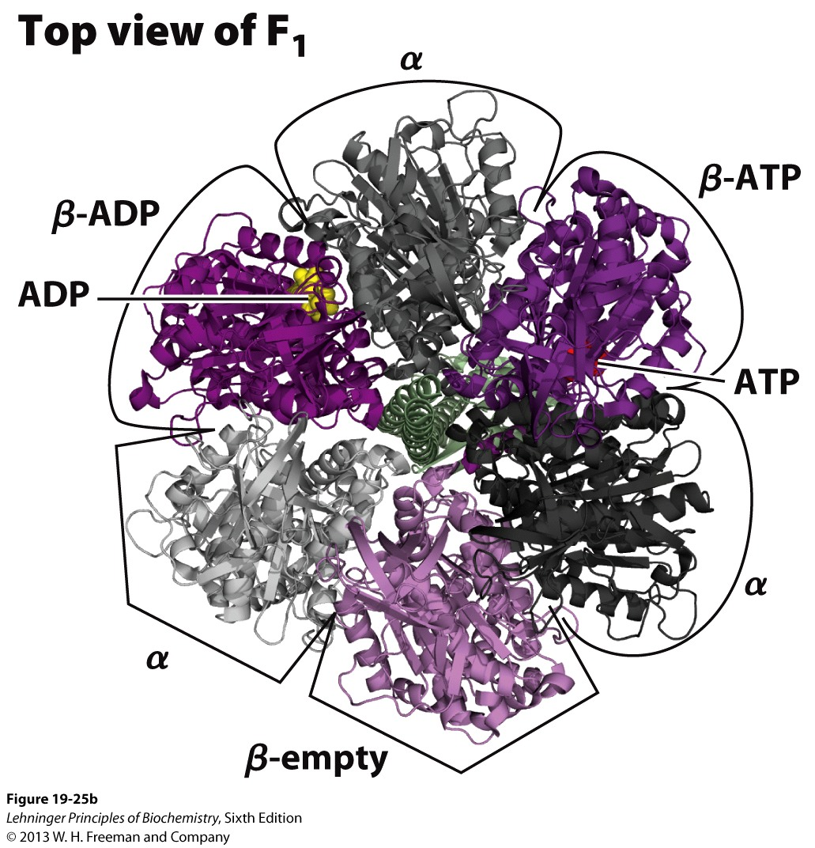
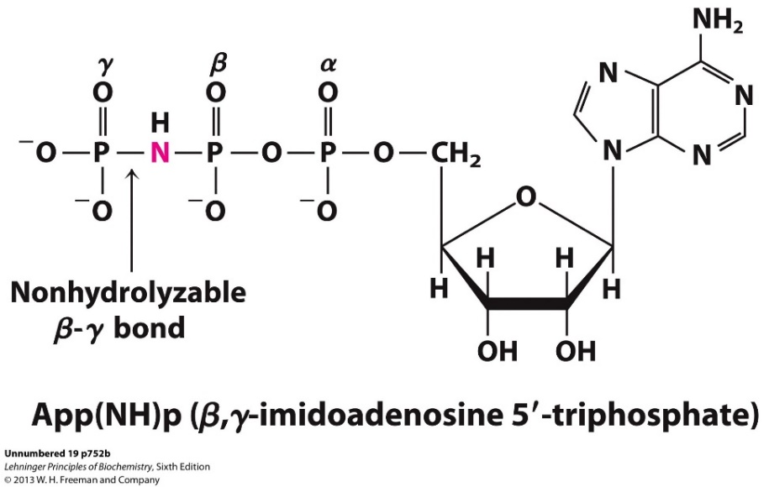
The β subunits could exist in three states: ATP-bound, ADP-bound, and empty

Slide 32
The γε “central stalk” determines conformation of the β subunits

Slide 33
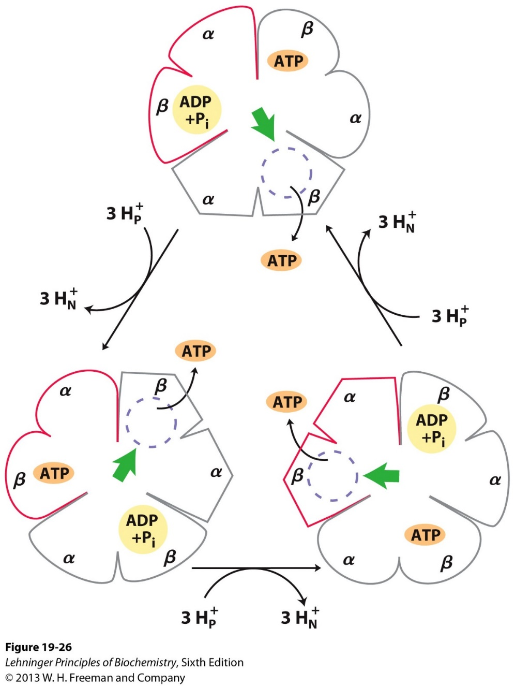
The “rotational catalysis” model of ATP synthase
Conformations of β subunits
ATP bound (tight)
ADP bound (loose)
Empty
Interaction of the γε central stalk determines the conformations of β subunits
Rotation of the γε central stalk inter-converts the three conformations of β subunits in cycles.

Slide 34
A detective story for understanding ATP synthesis
What makes ATP?
The proton gradient
Who makes ATP?
The F₁ ATPase/synthase
An unusual problem
ATP release
A solution
Conformational change
Who provides the solution?
The γε central stalk
The final link
The missing puzzle

Slide 35
The proton gradient drives the rotation of the γ rod

Slide 36
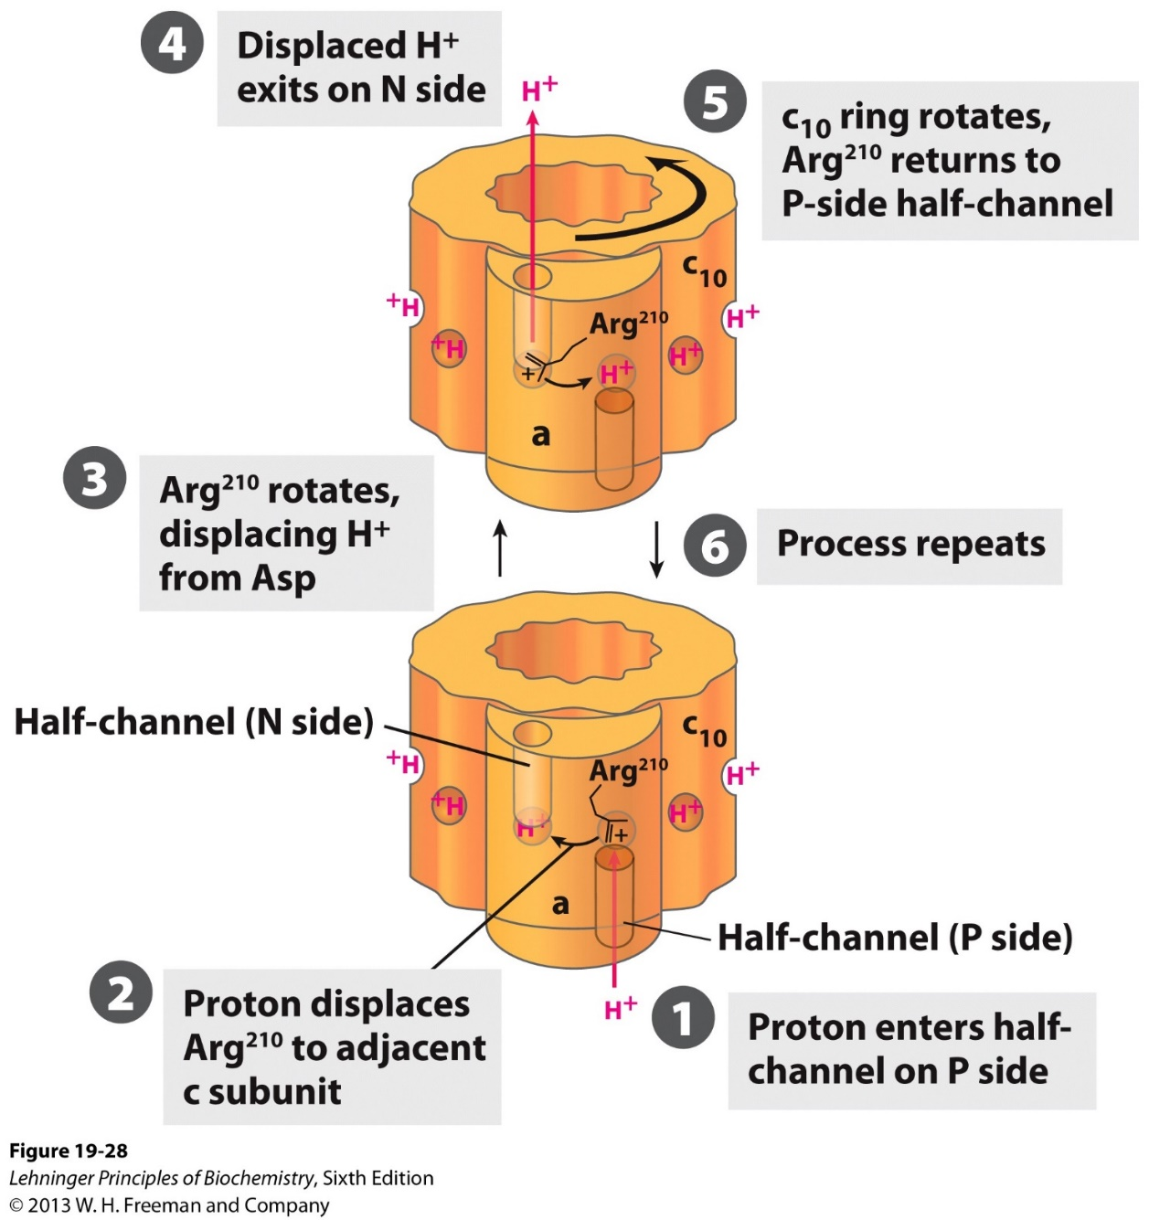
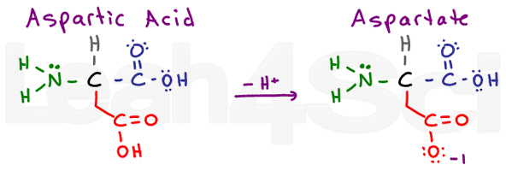
The proton gradient drives the rotation of the c ring
The a subunit of F0
Two half channels
Positive charged Arg
The c subunits of F0
Asp residues in the middle interact with protons
Protonated C subunit is pushed by hydrophobic interactions

Slide 37
A detective story for understanding ATP synthesis
What makes ATP?
The proton gradient
Who makes ATP?
The F₁ ATPase/synthase
An unusual problem
ATP release
A solution
Conformational change
Who provides the solution?
The γε central stalk
The final link
F₀ that transports H⁺
The missing puzzle
Two half channels

Slide 38
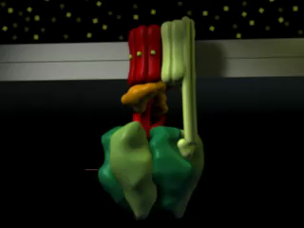

Slide 39
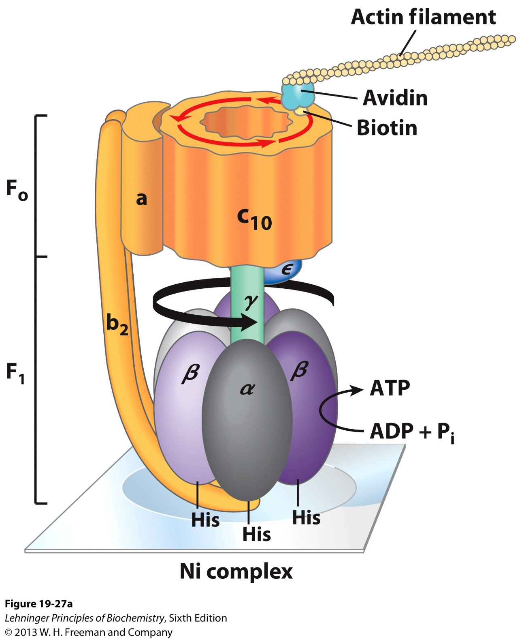
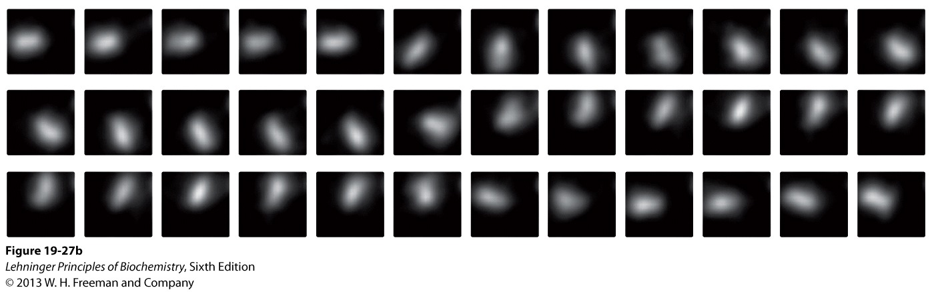
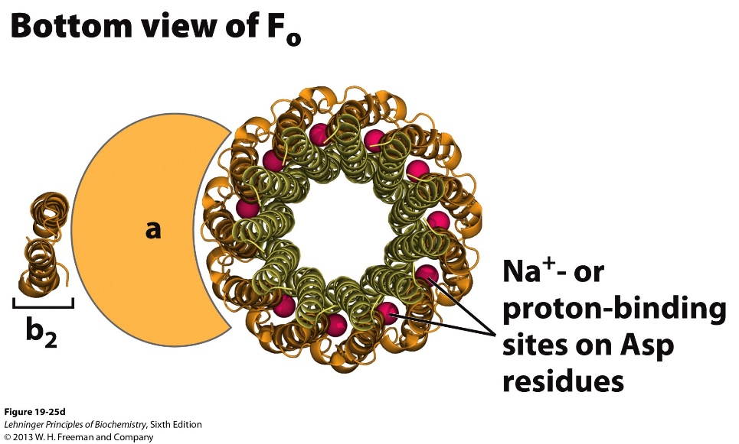
Experiments to visualize the rotation of the ATP synthase

Slide 40
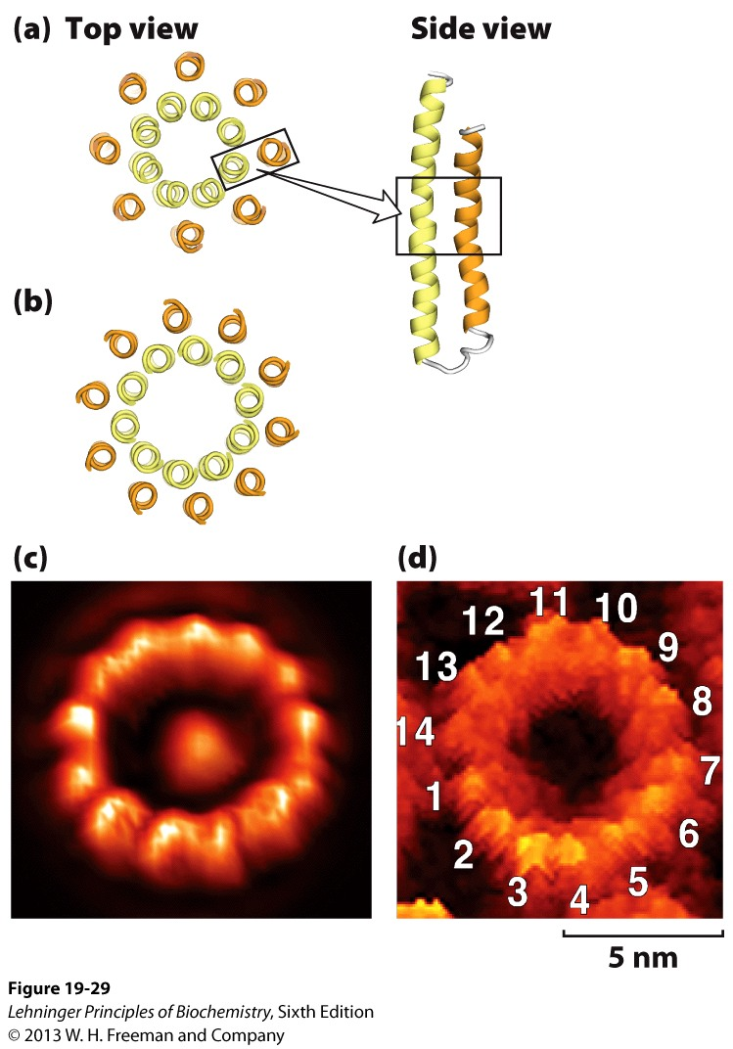
How many protons are need to produce 1 ATP?
A full circle of rotation = 3ATP
A full circle = number (N) of subunits in the C ring
N = 10 – 14 (take 12 for average)
Therefore, ~4 protons are needed to produce 1 ATP
Bovine: 8
Yeast: 10

Slide 41
How many ATP does one NADH generate?
What about one FADH₂
How many ATP does one glucose generate?

